Slide 1
Black Hole Astrophysics Chapters 6.5.2. & 6.6.2.2 & 7.1~7.3
All figures extracted from online sources of from the textbook.

Slide 2
Flowchart
Fluids in Special Relativity
Conservation laws and the equations of motion
The Electromagnetic Stress Tensor
What’s wrong with Newtonian Gravity?
What does matter do to spacetime?
What does it mean to be curved?
Gravity & Spacetime
How can we more quantitatively describe curvature?
Meaning of gauge
How to calculate the metric
GR without sources
The Schwarchild metric

Slide 3
Fluids in Special Relativity

Slide 4
The equations of motion

Slide 5
The Electromagnetic Stress Tensor

Slide 6
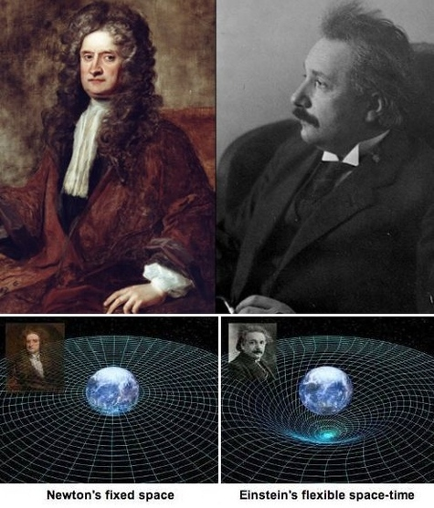
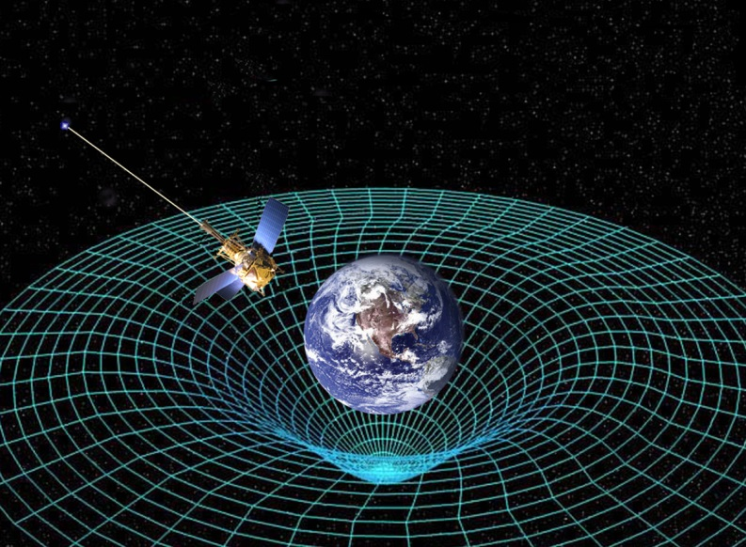
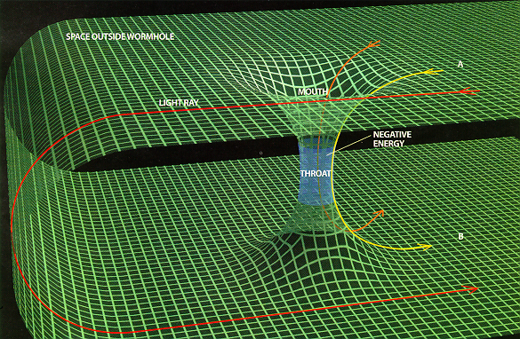
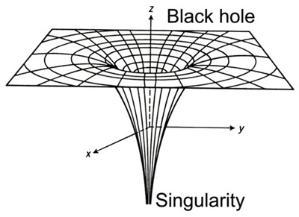

Slide 7
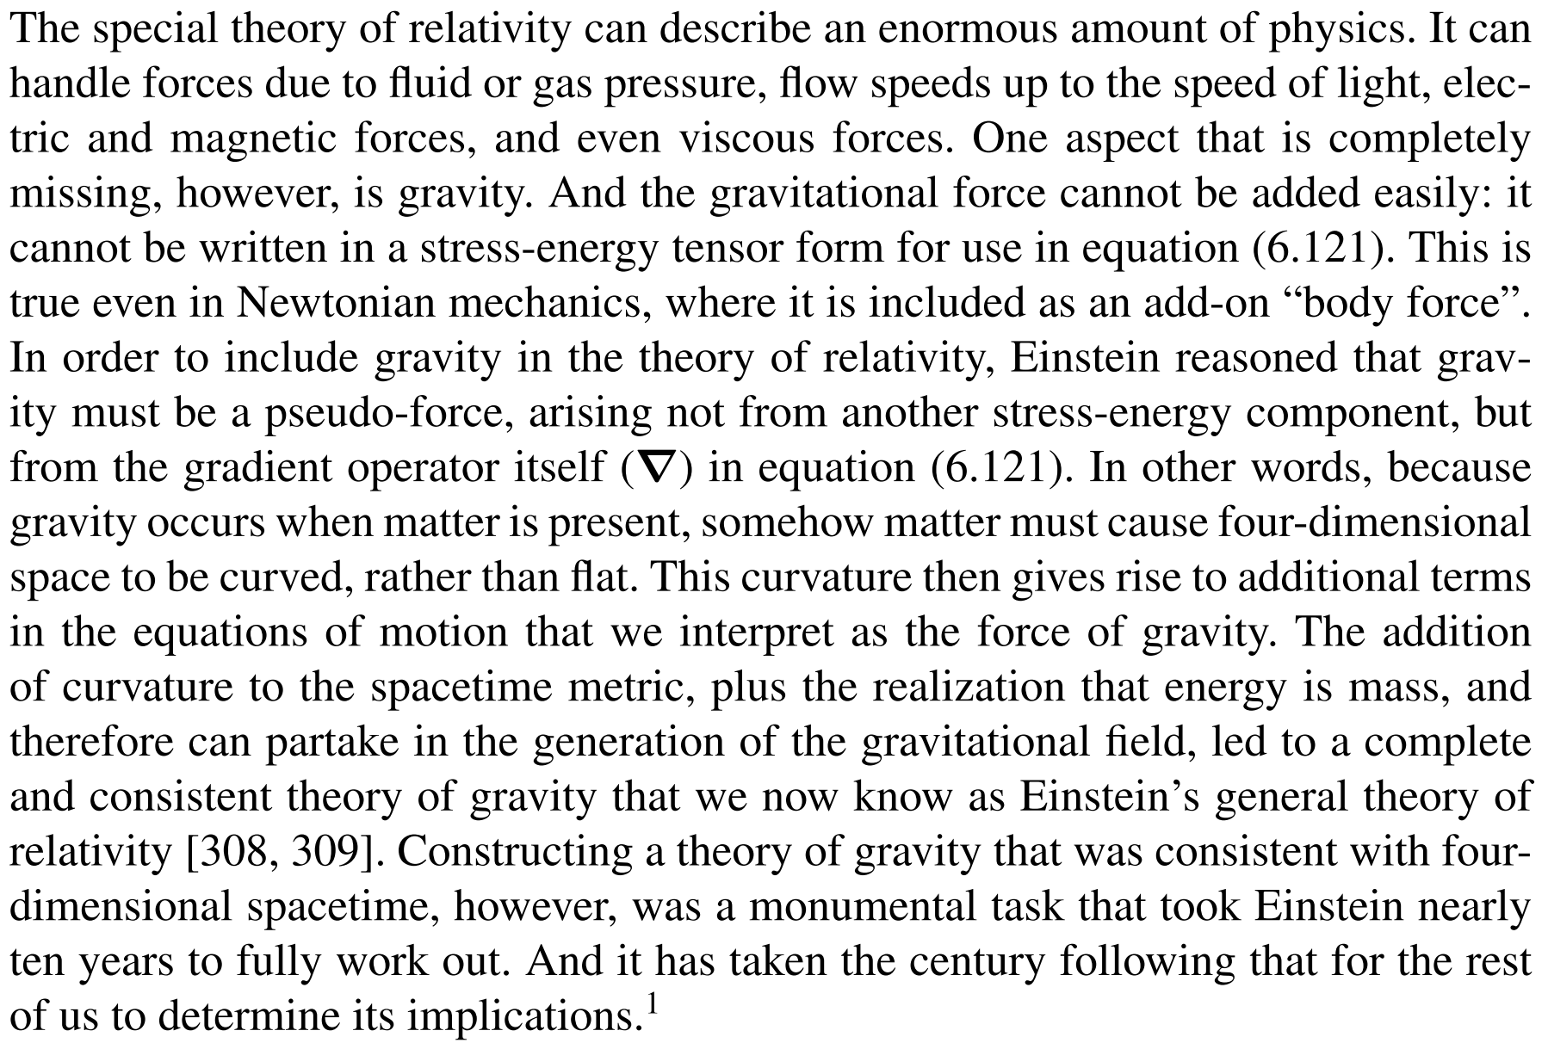
Overview

Slide 8
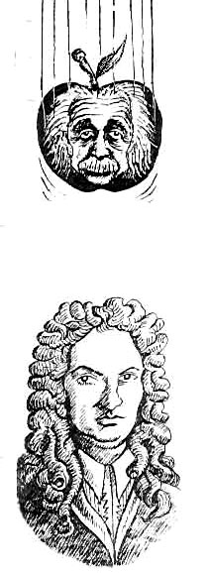
What’s wrong with Newtonian Gravity?
Recall the basic assumptions of Special Relativity:
1. Physics is the same in any inertial frame of reference
2. Speed of light is the same for all observers
How about Newtonian Gravity?
1. The effects of gravity propagates instantaneously
2. $∇^{2}φ=4⁢π⁢G⁢ρ$ only contains $ρ$ term, it has different values in different frames!
$ρ$ can’t be a scalar quantity but actually part of the stress energy tensor as we have seen.
Violates the speed limit of special relativity.
We need a proper tensor theory of Gravity that reduces to produce Newtonian Gravity in limiting cases.
By extension of $∇^{2}φ=4⁢π⁢G⁢ρ$, we would expect the tensor form to look like $G^{αβ}=K⁢G⁢T^{αβ}$. Where $⁢T^{αβ}$ contains $⁢ρ$ as one of its terms.

Slide 9
So, our goal today is …
1. To find $G^{αβ}$ that will produce the Einstein equation $G^{αβ}=K⁢G⁢T^{αβ}$ and find the proportionality constant K
2. Apply it to find the metric of a Schwarzschild Black Hole

Slide 10
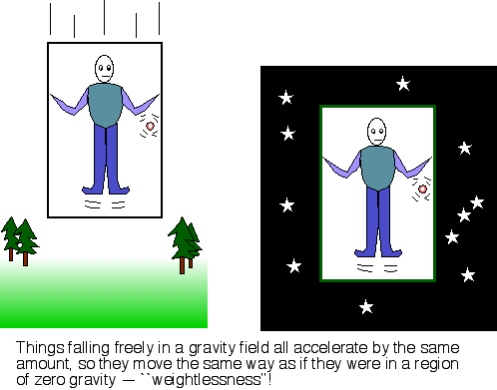
Let’s cut the cable
Previously, we have discussed properties of spacetime using the Minkowski metric. There, we never took gravity into account.
But as far as we knew, for any observer in an inertial frame, he feels spacetime behaving as the Minkowski metric tells it to.
Consider a freely falling elevator, people, as well as anything in it will feel as if there were no gravity. Basically a similar concept as the “imaginary force” used in classical mechanics to describe accelerating frames.
Einstein took an extension of this idea to say that the freely falling frame is the actual inertial one! Therefore people in it see spacetime behaving as the Minkowski metric says!

Slide 11
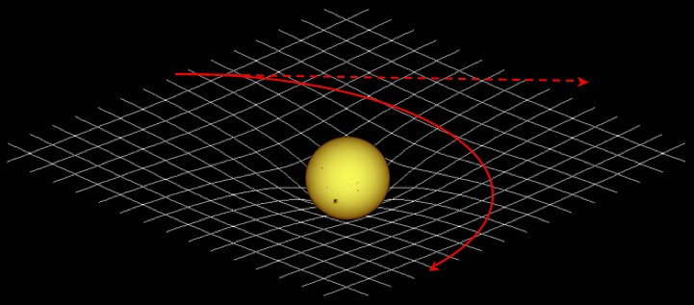
What does all this mean for spacetime?
Now, assuming freely falling frames are inertial, this means that different observers placed in a non-uniform gravity field must be in different accelerating frames relative to each other.
An observer freely falling sees others accelerating with respect to him!
When there is gravity around, it becomes impossible to create a inertial frame in which no one is accelerating! Thus, the metric now is a function of position! Different observers at different locations are in different accelerating frames thus measures things differently!
Sorry, I don’t have a very simple way of connecting these two concepts directly.
We call this type of spacetime as being curved! Spacetime is being bent by the existence of mass-energy!

Slide 12
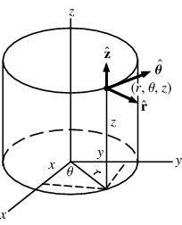
What does it mean to be curved?
The basic idea: Two initially parallel lines don’t remain parallel after extending in the original direction.
Simple method: Since initially parallel lines remain parallel in Euclidian space, if we can find a global transform between the metric of interest and the Euclidian one, then it must be flat.
To determine if there is a global transform between the two, review the section in 6.2.4
For the surface of a cylinder,
$${dh}^{2}=R^{2}⁢{dϕ}^{2}+{dz}^{2}={\left(\left.d[Rϕ\right]\right)}^{2}+{dz}^{2}$$
Then, redefining $d\left[Rϕ\right]→dx;dz→dy$, we retain ${dh}^{2}={dx}^{2}+{dy}^{2}$
Therefore, the surface of a cylinder is flat!

Slide 13
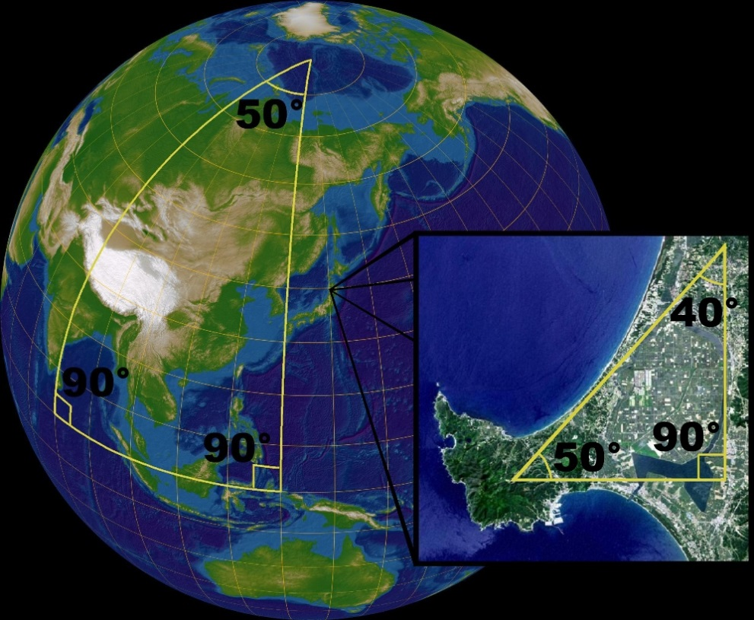
What does it mean to be curved?
For the surface of a sphere,
$${dh}^{2}=r^{2}⁢{dθ}^{2}+r^{2}⁢\sin^{2}⁢θ⁢{dϕ}^{2}$$
We find it is impossible to find a global transform to retain ${dh}^{2}={dx}^{2}+{dy}^{2}$
Therefore, the surface of a sphere is curved!
Another way is to consider the figure on the left:
At the equator, there are two parallel lines (since both are at right angles to the equator).
However, extending them and one finds that they meet at the pole! They are no longer parallel!

Slide 14
A connection to Gravity
Before we continue, one interesting thing to note here is that although the Earth as a whole is a curved a surface. But we never draw town maps as if they were on a curved surface.
What this means is that locally, a small patch of the sphere looks more or less flat!
Recall that a few slides ago, we said that spacetime is curved by matter, but as we have also shown, locally, we can still find some frame that looks follows the Minkowski metric. Thus, gravity also has the similar property of being locally flat but globally curved!

Slide 15
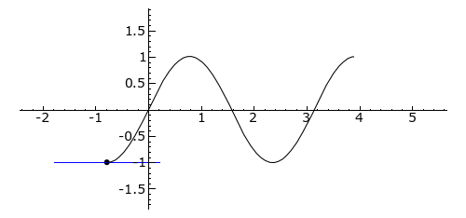
How do we test curvature more precisely?
Although illustrative, but for higher dimensions it wouldn’t be trivial to “see” if two initially parallel lines remain parallel or even try to do global transformations on them. Therefore, to treat higher dimension spaces, we use the method introduced by Georg Friedrich Bernhard Riemann in the mid 1800s – to compute the Riemann tensor.
Recall that in Calculus, we learned that for a 1D function f(x),
The first derivative $\frac{df⁢\left(x\right)}{dx}$ gives us the slope of the function at some point, whereas the second derivative $\frac{df⁢{\left(x\right)}^{2}}{{dx}^{2}}$ gives us the curvature (concave/convex).

Slide 16
A hell lot of terms!
To compute the Riemann tensor also requires taking second derivatives. We need to consider every possible second derivative on each term of the metric.
For N dimensional space, there are$N×N$ possible second derivatives and also $N×N$ terms in the metric.
This amounts to $N^{4}$ terms for N dimensional spaces. (256 for 4D!)
$$\left(\begin{matrix}−1 & 0 & 0 & 0 \\ 0 & 1 & 0 & 0 \\ 0 & 0 & 1 & 0 \\ 0 & 0 & 0 & 1\end{matrix}\right)$$
For example, in 4D spacetime, the Minkowski metric has $4×4=16$ terms.
And all possible second derivatives are as follows (also 16):
$$\frac{∂^{2}}{∂t^{2}}, \frac{∂^{2}}{∂x^{2}},\frac{∂^{2}}{∂y^{2}},\frac{∂^{2}}{∂z^{2}},\frac{∂^{2}}{∂t⁢∂x},\frac{∂^{2}}{∂x⁢∂t},\frac{∂^{2}}{∂t⁢∂y},\frac{∂^{2}}{∂y⁢∂t},\frac{∂^{2}}{∂t⁢∂z},\frac{∂^{2}}{∂z⁢∂t},\frac{∂^{2}}{∂x⁢∂y},\frac{∂^{2}}{∂y⁢∂x},\frac{∂^{2}}{∂x⁢∂z},\frac{∂^{2}}{∂z⁢∂x},\frac{∂^{2}}{∂y⁢∂z},\frac{∂^{2}}{∂z⁢∂y}$$
However, as we can already see, there must be some symmetries in the Riemann tensor that will allow us to get rid of lots of terms.

Slide 17
The Riemann Tensor
Without going into detail, the Riemann tensor is defined as:
$$R_{αβγδ}=\frac{∂Γ_{αβδ}}{∂x^{γ}}−\frac{∂Γ_{αβγ}}{∂x^{δ}}+g^{μν}⁢\left(Γ_{μαδ}⁢Γ_{νβγ}−Γ_{μαγ}⁢Γ_{νβδ}\right)$$
We can see that it is composed of the difference of two terms
Where the $Γ_{αβγ}$ terms are related to the metric as:
$$Γ_{αβγ}=\frac{1}{2}⁢\left(\frac{∂g_{αβ}}{∂x^{γ}}+\frac{∂g_{αγ}}{∂x^{β}}−\frac{∂g_{βγ}}{∂x^{α}}\right)$$
BAD SLIDE
They are called the Christoffel symbols.
Now, we can see that the Riemann tensor is related to the metric through the second derivative.

Slide 18
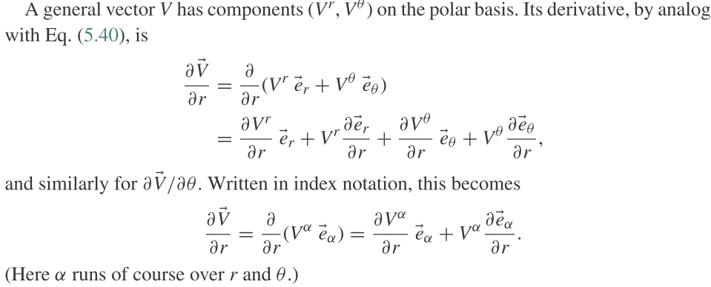
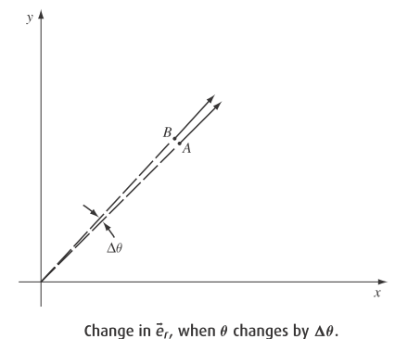
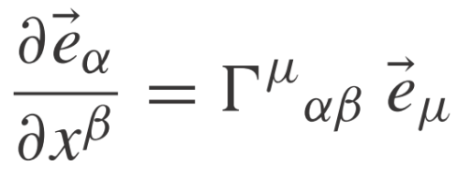
Meaning of the Christoffel symbols
BAD SLIDE

Slide 19
Hooray! Let’s do away with the terms! Algebraic Symmetries of the Riemann Tensor
From the definition of the Riemann Tensor and Christoffel symbols,
$$R_{αβγδ}=\frac{∂Γ_{αβδ}}{∂x^{γ}}−\frac{∂Γ_{αβγ}}{∂x^{δ}}+g^{μν}⁢\left(Γ_{μαδ}⁢Γ_{νβγ}−Γ_{μαγ}⁢Γ_{νβδ}\right)$$
$$Γ_{αβγ}=\frac{1}{2}⁢\left(\frac{∂g_{αβ}}{∂x^{γ}}+\frac{∂g_{αγ}}{∂x^{β}}−\frac{∂g_{βγ}}{∂x^{α}}\right)$$
We can find that
$$R_{αβδγ}=−R_{αβγδ}$$
$$R_{γδαβ}=R_{αβγδ}$$
$$R_{αβδγ}=−R_{βαδγ}$$
$$R_{ααγδ}=R_{αβγγ}=0$$
And the first Bianchi identity:
$$R_{αβγδ}+R_{αδβγ}+R_{αγδβ}=0$$
Putting this all together, we find that the number of independent terms is # as follows:
$$\begin{matrix}\#=\frac{1}{8}⁢\left(N^{4}−2⁢N^{3}+3⁢N^{2}−2⁢N\right) & N<4 \\ \#=\frac{1}{8}⁢\left(N^{4}−2⁢N^{3}+3⁢N^{2}−2⁢N\right)−\frac{N!}{4!⁢\left(N−4\right)!} & N≥4\end{matrix}$$
This means that we only have 1,6,20 potentially non-zero independent terms for 2,3,4 dimensions respectively!

Slide 20
Differential symmetry of the Riemann Tensor
The Riemann Tensor also possesses differential symmetries, sometimes called the second Bianchi identity or simply Bianchi identity.
$$∇_{γ}R_{μναβ}+∇_{β}R_{μνγα}+∇_{α}R_{μνβγ}=0$$
This identity does not decrease the number of components of the tensor that we need to calculate, but it does have profound importance for Einstein’s theory of gravity and for fundamental laws of physics.

Slide 21
Example Riemann Tensors
Previously, we have argued that the surface of a cylinder is flat and the surface of a sphere isn’t. How do we show that using Riemann Tensors?
$$R_{αβγδ}=\frac{∂Γ_{αβδ}}{∂x^{γ}}−\frac{∂Γ_{αβγ}}{∂x^{δ}}+g^{μν}⁢\left(Γ_{μαδ}⁢Γ_{νβγ}−Γ_{μαγ}⁢Γ_{νβδ}\right)$$
$$Γ_{αβγ}=\frac{1}{2}⁢\left(\frac{∂g_{αβ}}{∂x^{γ}}+\frac{∂g_{αγ}}{∂x^{β}}−\frac{∂g_{βγ}}{∂x^{α}}\right)$$
Example1.
For the surface of a cylinder, the metric is ${dh}^{2}=r^{2}⁢{dϕ}^{2}+{dz}^{2}$
Since $r$ is constant, this means that all of the Christoffel symbols $Γ_{αβγ}$ must be zero.
Which in turn means that the Riemann tensor $R_{αβγδ}$ is also zero.
Thus, the surface of a cylinder is flat.

Slide 22
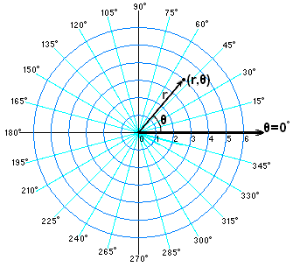
Example Riemann Tensors
Previously, we have argued that the surface of a cylinder is flat and the surface of a sphere isn’t. How do we show that using Riemann Tensors?
$$R_{αβγδ}=\frac{∂Γ_{αβδ}}{∂x^{γ}}−\frac{∂Γ_{αβγ}}{∂x^{δ}}+g^{μν}⁢\left(Γ_{μαδ}⁢Γ_{νβγ}−Γ_{μαγ}⁢Γ_{νβδ}\right)$$
$$Γ_{αβγ}=\frac{1}{2}⁢\left(\frac{∂g_{αβ}}{∂x^{γ}}+\frac{∂g_{αγ}}{∂x^{β}}−\frac{∂g_{βγ}}{∂x^{α}}\right)$$
Example2.
Before we go to the sphere, lets consider polar coordinates on a flat piece of paper which has the metric ${dh}^{2}=r^{2}⁢{dθ }^{2}+{dr}^{2}$
Now r isn’t constant, however, for 2D problems, we only have 1 independent non-zero term.
Using $Γ_{212}=Γ_{221}=−Γ_{122}=r$ and $g^{11}=1;g^{22}=1/{r^{2}}$, we find that $R_{1212}=−1+1=0$
Thus, it is also flat, as expected.

Slide 23
Example Riemann Tensors
Previously, we have argued that the surface of a cylinder is flat and the surface of a sphere isn’t. How do we show that using Riemann Tensors?
$$R_{αβγδ}=\frac{∂Γ_{αβδ}}{∂x^{γ}}−\frac{∂Γ_{αβγ}}{∂x^{δ}}+g^{μν}⁢\left(Γ_{μαδ}⁢Γ_{νβγ}−Γ_{μαγ}⁢Γ_{νβδ}\right)$$
$$Γ_{αβγ}=\frac{1}{2}⁢\left(\frac{∂g_{αβ}}{∂x^{γ}}+\frac{∂g_{αγ}}{∂x^{β}}−\frac{∂g_{βγ}}{∂x^{α}}\right)$$
Example3.
Finally, the surface of a sphere follows the metric ${dh}^{2}=r^{2}⁢{dθ}^{2}+r^{2}⁢\sin^{2}⁢θ⁢{dϕ}^{2}$
This gives $Γ_{212}=Γ_{221}=−Γ_{122}=r^{2}⁢sin⁢θcosθ$ and $g^{11}=1/r^{2};g^{22}=1/{r^{2}⁢\sin^{2}⁢θ}$
Then, $R_{1212}=r^{2}⁢\sin^{2}⁢θ$.

Slide 24
Now, back to gravity
Before we went into all that messy stuff of dealing with curvature, we had, based on simple analogies with Newtonian gravity argued that we had to find some equation that looked like like $G^{αβ}=K⁢G⁢T^{αβ}$.
As we have argued, gravity is nothing more than the manifestation of curved spacetime. Now that we have discussed all about how to describe curvature in general, we are finally in place to put things together.
However, the Riemann Tensor $R_{αβγδ}$ is a 4th rank tensor where as $G^{αβ}$ is only of 2nd rank. Therefore we must somehow manipulate the Riemann Tensor into a 2nd rank one.
Also, since $∇·\overset{↔}{T}=0$, we also require that $∇·\overset{↔}{G}=0.$

Slide 25
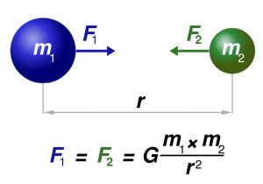
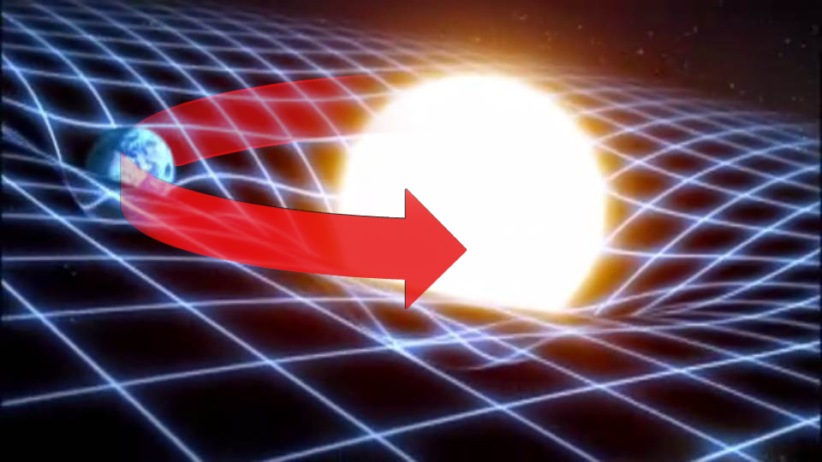
Our to do list
1. Find $G^{αβ}$ from the Riemann Tensor $R_{αβγδ}$.
2. $G^{αβ}$must satisfy $∇·\overset{↔}{G}=0.$
3. Find the proportionality constant K in $G^{αβ}=K⁢G⁢T^{αβ}$.
4. $G^{αβ}=K⁢G⁢T^{αβ}$ must reduce to $∇^{2}φ=4⁢π⁢G⁢ρ$ in limiting cases.

Slide 26
Finding a 2nd rank tensor from the Riemann Tensor
1. Find $G^{αβ}$ from the Riemann Tensor $R_{αβγδ}$.
2. $G^{αβ}$must satisfy $∇·\overset{↔}{G}=0.$
3. Find the proportionality constant K in $G^{αβ}=K⁢G⁢T^{αβ}$.
4. $G^{αβ}=K⁢G⁢T^{αβ}$ must reduce to $∇^{2}φ=4⁢π⁢G⁢ρ$ in limiting cases.
There are many ways to extract a 2nd rank tensor from a 4th rank one, but only a few will inherit the properties of the Bianchi identities. (why does it have to?)
One method would be to contract the metric with the Riemann Tensor
$$R_{αβ}≡g^{μν}⁢R_{μανβ}$$
$R_{αβ}$ is called the Ricci curvature tensor.
Then, $R_{αβ}$ inherits a differential symmetry property from the Riemann tensor’s Bianchi identity:
$$∇_{α}\left(g^{αλ}⁢R_{λβ}\right)−\frac{1}{2}⁢∇_{β}R=0$$
Where
$$R≡g^{βλ}⁢R_{λβ}$$
R is usually called the Ricci scalar.

Slide 27
Making a 2nd rank tensor that is divergence-free
1. Find $G^{αβ}$ from the Riemann Tensor $R_{αβγδ}$.
2. $G^{αβ}$must satisfy $∇·\overset{↔}{G}=0.$
3. Find the proportionality constant K in $G^{αβ}=K⁢G⁢T^{αβ}$.
4. $G^{αβ}=K⁢G⁢T^{αβ}$ must reduce to $∇^{2}φ=4⁢π⁢G⁢ρ$ in limiting cases.
However, from $∇_{α}\left(g^{αλ}⁢R_{λβ}\right)−\frac{1}{2}⁢∇_{β}R=0$, we can see that the Ricci tensor $R_{αβ}$isn’t divergence free.
But we can use this property to construct a divergence free tensor:
$$G^{αβ}≡R^{αβ}−\frac{1}{2}⁢g^{αβ}⁢R$$
It is actually the onle 2nd rank tensor that can be derived from the Riemann tensor and has all the necessary properties that we required!

Slide 28
Recap—from the metric to the Einstein Tensor
1. Find $G^{αβ}$ from the Riemann Tensor $R_{αβγδ}$.
2. $G^{αβ}$must satisfy $∇·\overset{↔}{G}=0.$
3. Find the proportionality constant K in $G^{αβ}=K⁢G⁢T^{αβ}$.
4. $G^{αβ}=K⁢G⁢T^{αβ}$ must reduce to $∇^{2}φ=4⁢π⁢G⁢ρ$ in limiting cases.
Now that we have
1. Worked out how the Riemann Tensor $R_{αβγδ}$ related to the metric.
$R_{αβγδ}=\frac{∂Γ_{αβδ}}{∂x^{γ}}−\frac{∂Γ_{αβγ}}{∂x^{δ}}+g^{μν}⁢\left(Γ_{μαδ}⁢Γ_{νβγ}−Γ_{μαγ}⁢Γ_{νβδ}\right)$ ; $Γ_{αβγ}=\frac{1}{2}⁢\left(\frac{∂g_{αβ}}{∂x^{γ}}+\frac{∂g_{αγ}}{∂x^{β}}−\frac{∂g_{βγ}}{∂x^{α}}\right)$
2. Found the relation between the Riemann Tensor $R_{αβγδ}$ and the Einstein Tensor $G^{αβ}$.
$$G^{αβ}≡R^{αβ}−\frac{1}{2}⁢g^{αβ}⁢R=g_{μν}⁢R^{μανβ}−\frac{1}{2}⁢g^{αβ}g^{γδ}⁢g^{μν}⁢R_{μδνγ}$$
We are in good position to finally tackle the proportionality constant K.
How we go about doing this is through the idea that Newtonian Gravity is actually a weak field limit of General Relativity.

Slide 29
The final link – the proportionality constant
1. Find $G^{αβ}$ from the Riemann Tensor $R_{αβγδ}$.
2. $G^{αβ}$must satisfy $∇·\overset{↔}{G}=0.$
3. Find the proportionality constant K in $G^{αβ}=K⁢G⁢T^{αβ}$.
4. $G^{αβ}=K⁢G⁢T^{αβ}$ must reduce to $∇^{2}φ=4⁢π⁢G⁢ρ$ in limiting cases.
For the limit of weak gravity, we can guess that the metric should look almost Minkowskian, something like this: $\left(\begin{matrix}−1+h_{tt} & 0 & 0 & 0 \\ 0 & 1+h_{xx} & 0 & 0 \\ 0 & 0 & 1+h_{yy} & 0 \\ 0 & 0 & 0 & 1+h_{zz}\end{matrix}\right)$
To relate them with Newtonian Gravity, all we need is $g^{ii}⁢Γ_{itt}≈−\frac{1}{2}⁢\frac{∂h_{tt}}{∂x^{i}}$
The next bit I don’t fully understand so I just cut the text out for completeness.

Slide 30
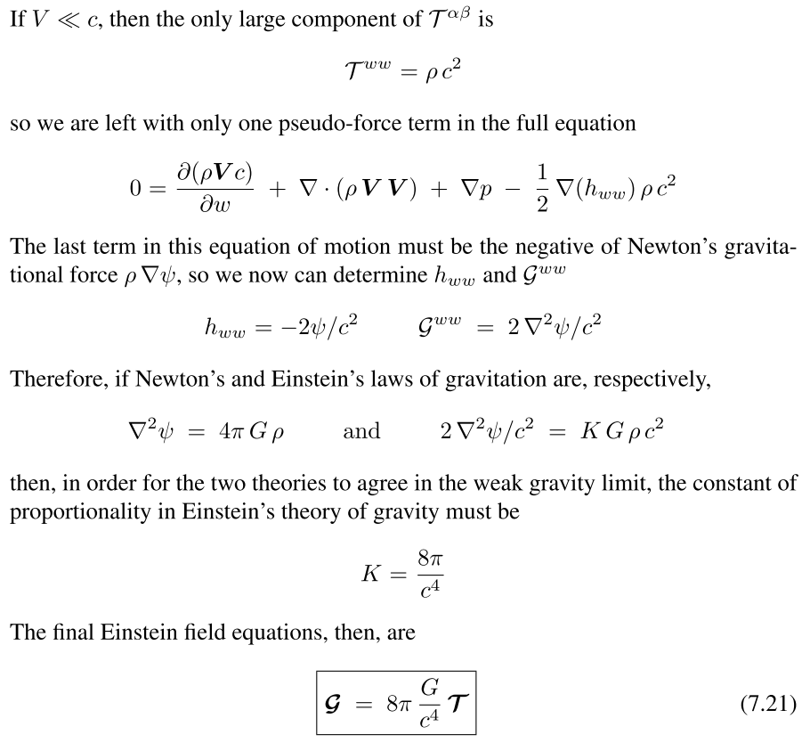
BAD SLIDE

Slide 31
Meaning of gauge
The fact that $∇·\overset{↔}{G}$ tells us that the number of useful equations in $G^{αβ}=8⁢π⁢G⁢T^{αβ}$ reduces to only 6.
The theory thus allows for gauge freedom for us to construct 4 independent conditions on the metric that we lost as conservation laws.
What is the interpretation of gauge in GR?
The answer is that the gauge is simply the coordinate system itself!
The gauge is the coordinate system, and the gauge transformation is the generalized Lorentz transform!

Slide 32
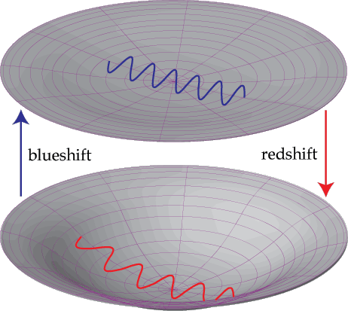
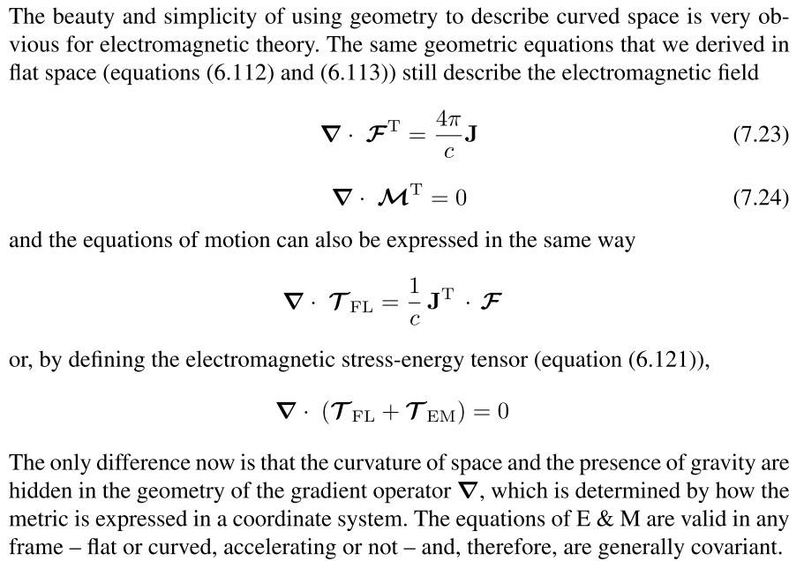
E&M in 4D curved space

Slide 33
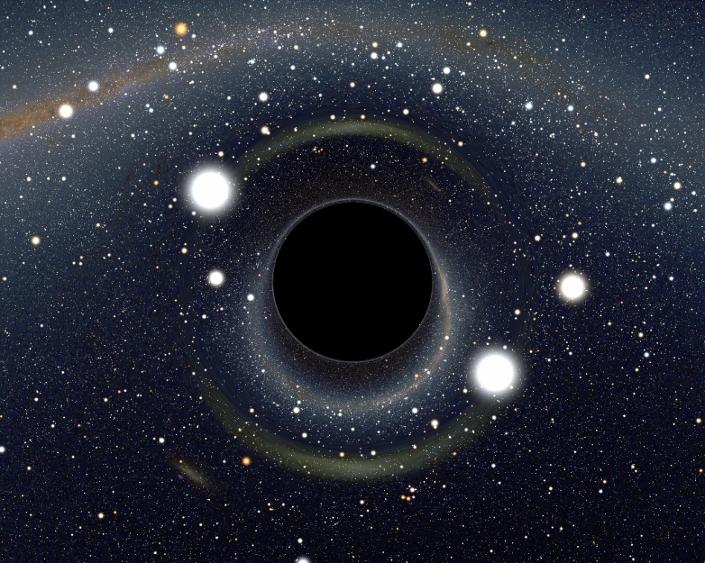
Curvature without local matter
Since $G^{αβ}≡R^{αβ}−\frac{1}{2}⁢g^{αβ}⁢R=g_{μν}⁢R^{μανβ}−\frac{1}{2}⁢g^{αβ}g^{γδ}⁢g^{μν}⁢R_{μδνγ},$
Even if $G^{αβ}=T^{αβ}=0$, this doesn’t mean that the Riemann curvature tensor $R^{αβγδ}$ must also be zero, i.e. not necessarily flat.
Non-zero components of $R^{αβγδ}$ can sum to be zero when calculating $G^{αβ}$.
This actually happens quite often, as long as we are in a region without sources of curvature (i.e. the stress-energy tensor is zero there), then $G^{αβ}$ must be zero there.
However, we might as well be right next to a black hole where the curvature is severe! This is the situation we will be dealing with as an Example.

Slide 34
How to calculate a metric?
Now, let say we want to find the metric to some distribution of mass-energy as described by $T^{αβ}$.
We know that…
$R_{αβγδ}=\frac{∂Γ_{αβδ}}{∂x^{γ}}−\frac{∂Γ_{αβγ}}{∂x^{δ}}+g^{μν}⁢\left(Γ_{μαδ}⁢Γ_{νβγ}−Γ_{μαγ}⁢Γ_{νβδ}\right)$ ; $Γ_{αβγ}=\frac{1}{2}⁢\left(\frac{∂g_{αβ}}{∂x^{γ}}+\frac{∂g_{αγ}}{∂x^{β}}−\frac{∂g_{βγ}}{∂x^{α}}\right)$
$$G^{αβ}≡R^{αβ}−\frac{1}{2}⁢g^{αβ}⁢R=g_{μν}⁢R^{μανβ}−\frac{1}{2}⁢g^{αβ}g^{γδ}⁢g^{μν}⁢R_{μδνγ}$$
$$G^{αβ}=8⁢π⁢G⁢T^{αβ}$$
So…
All we have to do is to use some assumptions to “guess” the form of the metric.
Then send the metric through the pipeline and solve the 10 equations so that $G^{αβ}=8⁢π⁢G⁢T^{αβ}$ is fully satisfied.
This might seem a daunting task, but lets look at the example of a lonely black hole and we’ll see that it isn’t so terrible after all.

Slide 35
A lonely and non-spinning BH – Assumptions to the Schwarzschild metric
-1. Any general metric
0. The metric is a symmetric tensor
$$g_{αβ}=\left(\begin{matrix}g_{00} & g_{01} & g_{02} & g_{03} \\ g_{10} & g_{11} & g_{12} & g_{13} \\ g_{20} & g_{21} & g_{22} & g_{23} \\ g_{30} & g_{31} & g_{32} & g_{33}\end{matrix}\right)$$
$$g_{αβ}=\left(\begin{matrix}g_{00} & g_{01} & g_{02} & g_{03} \\ g_{01} & g_{11} & g_{12} & g_{13} \\ g_{02} & g_{12} & g_{22} & g_{23} \\ g_{03} & g_{13} & g_{23} & g_{33}\end{matrix}\right)$$
1. Spherically symmetric
a. choose to use spherical coordinates $(t,r,θ,φ)$
b. unchanged under $θ$,$φ$ reversals ($θ→−θ$,$φ→−φ$)
$$g_{αβ}=\left(\begin{matrix}g_{00} & g_{01} & 0 & 0 \\ g_{01} & g_{11} & 0 & 0 \\ 0 & 0 & g_{22} & 0 \\ 0 & 0 & 0 & g_{33}\end{matrix}\right)$$
$$g_{αβ}=\left(\begin{matrix}g_{00} & 0 & 0 & 0 \\ 0 & g_{11} & 0 & 0 \\ 0 & 0 & g_{22} & 0 \\ 0 & 0 & 0 & g_{33}\end{matrix}\right)$$
2. Static
a. $\frac{∂g_{μν}}{∂t}=0$
b. unchanged under $t$reversals $(t→−t)$
3. Solution is in vacuum $G^{αβ}=8⁢π⁢G⁢T^{αβ}=0$

Slide 36
The Christoffel Symbols
$${ds}^{2}=g_{00}⁢{dt}^{2}+g_{11}⁢{dr}^{2}+g_{22}⁢{dθ}^{2}+g_{33}⁢{dϕ}^{2}$$
$$g_{αβ}=\left(\begin{matrix}g_{00} & 0 & 0 & 0 \\ 0 & g_{11} & 0 & 0 \\ 0 & 0 & g_{22} & 0 \\ 0 & 0 & 0 & g_{33}\end{matrix}\right)$$
$$g_{αβ}=\left(\begin{matrix}B\left(r\right) & 0 & 0 & 0 \\ 0 & A\left(r\right) & 0 & 0 \\ 0 & 0 & r^{2} & 0 \\ 0 & 0 & 0 & r^{2}\sin^{2}θ\end{matrix}\right)$$
$$Γ_{tαβ}=\left(\begin{matrix}0 & \frac{B′}{2} & 0 & 0 \\ \frac{B′}{2} & 0 & 0 & 0 \\ 0 & 0 & 0 & 0 \\ 0 & 0 & 0 & 0\end{matrix}\right)$$
$$Γ_{θαβ}=\left(\begin{matrix}0 & 0 & 0 & 0 \\ 0 & 0 & r & 0 \\ 0 & r & 0 & 0 \\ 0 & 0 & 0 & −r^{2}⁢sinθcosθ\end{matrix}\right)$$
$$Γ_{rαβ}=\left(\begin{matrix}\frac{−B′}{2} & 0 & 0 & 0 \\ 0 & \frac{A′}{2} & 0 & 0 \\ 0 & 0 & −r & 0 \\ 0 & 0 & 0 & −{rsin}^{2}⁢θ\end{matrix}\right)$$
$$Γ_{ϕαβ}=\left(\begin{matrix}0 & 0 & 0 & 0 \\ 0 & 0 & 0 & {rsin}^{2}⁢θ \\ 0 & 0 & 0 & r^{2}⁢sinθcosθ \\ 0 & {rsin}^{2}⁢θ & r^{2}⁢sinθcosθ & 0\end{matrix}\right)$$

Slide 37
Derivation of the Schwarzschild metric
$$g_{αβ}=\left(\begin{matrix}B\left(r\right) & 0 & 0 & 0 \\ 0 & A\left(r\right) & 0 & 0 \\ 0 & 0 & r^{2} & 0 \\ 0 & 0 & 0 & r^{2}\sin^{2}θ\end{matrix}\right)$$
$$R_{αβγδ}=\frac{∂Γ_{αβδ}}{∂x^{γ}}−\frac{∂Γ_{αβγ}}{∂x^{δ}}+{Γ^{ν}}_{αδ}⁢Γ_{νβγ}−{Γ^{ν}}_{αγ}Γ_{νβδ}$$
$$G^{αβ}≡R^{αβ}−\frac{1}{2}⁢g^{αβ}⁢R=g_{μν}⁢R^{μανβ}−\frac{1}{2}⁢g^{αβ}g^{γδ}⁢g^{μν}⁢R_{μδνγ}$$
$$G^{αβ}=8⁢π⁢G⁢T^{αβ}=0$$

Slide 38
Derivation of the Schwarzschild metric
$$G^{αβ}=8⁢π⁢G⁢T^{αβ}=0$$
$$4⁢\overset{.}{A}⁢B^{2}−2⁢r⁢\overset{..}{B}⁢A⁢B+r⁢\overset{.}{A}⁢\overset{.}{B}⁢B+r⁢{\overset{.}{B}}^{2}⁢A=0$$
$$−2⁢r⁢\overset{..}{B}⁢A⁢B+r⁢\overset{.}{A}⁢\overset{.}{B}⁢B+r⁢{\overset{.}{B}}^{2}⁢A−4⁢\overset{.}{B}⁢A⁢B=0$$
$$r⁢\overset{.}{A}⁢B+2⁢A^{2}⁢B−2⁢A⁢B−r⁢\overset{.}{B}⁢A=0$$
$$\overset{.}{A}⁢B+\overset{.}{B}⁢A=0→\frac{d}{dr}⁢\left(AB\right)=0→A⁢\left(r\right)⁢B⁢\left(r\right)≡K$$
$$r⁢\overset{.}{A}⁢\frac{K}{A}+2⁢K⁢A−2⁢K+r⁢\overset{.}{A}⁢\frac{K}{A}=2⁢K⁢\left(r⁢\frac{\overset{.}{A}}{A}+A−1\right)=0→r⁢\overset{.}{A}=A⁢\left(1−A\right)$$
$$A⁢\left(r\right)=\frac{1}{\left(1+\frac{1}{S⁢r}\right)}$$
$$B⁢\left(r\right)=K⁢\left(1+\frac{1}{S⁢r}\right)$$
$${ds}^{2}=K⁢\left(1+\frac{1}{S⁢r}\right)⁢{dt}^{2}+\frac{{dr}^{2}}{\left(1+\frac{1}{S⁢r}\right)}+r^{2}⁢{dθ}^{2}+r^{2}⁢\sin^{2}⁢θ⁢{dϕ}^{2}$$

Slide 39
The coefficients
Next Week!

Slide 40
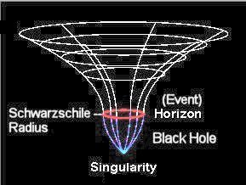
The Schwarzschild metric

